Slide 1
04282020

Slide 2
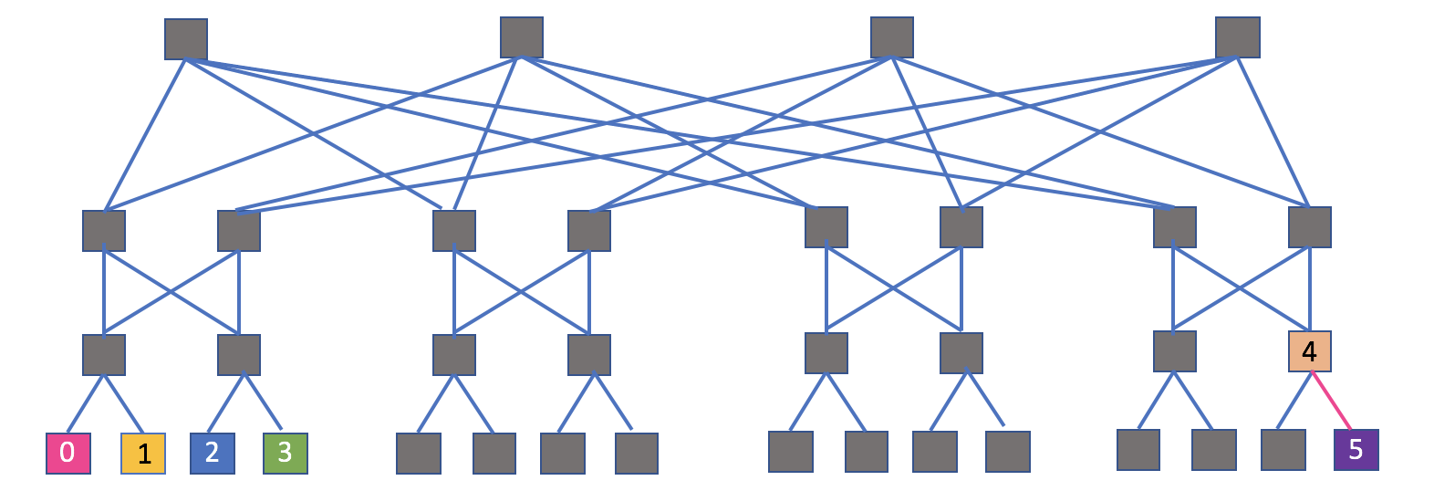
Set up:
Incast, single node, 4 connections, 2 hosts per edge switch
100Gbps
Scheduler applied here
40Gbps
Classify based on fid
1us*12=12us

Slide 3
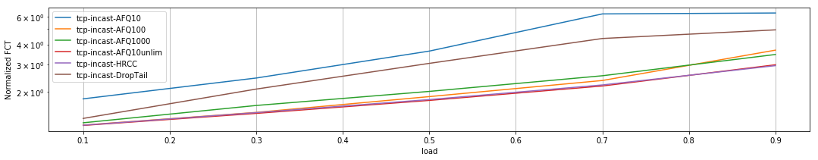
Mean FCT over all flows
Packet classification based on src/dst address
Packet classification based on fid

Slide 4
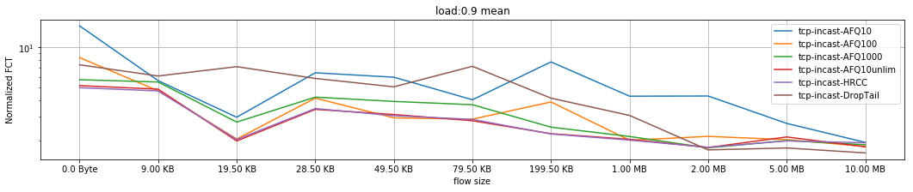
FCT of flows with different sizes
Packet classification based on src/dst address
Packet classification based on fid

Slide 5
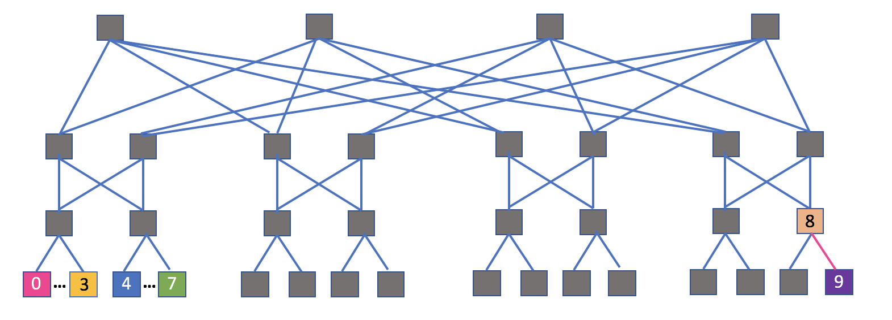
Set up:
Incast, single node, 8 connections, 4 hosts per edge switch
100Gbps
Scheduler applied here
40Gbps
Classify based on fid
1us*12=12us

Slide 6
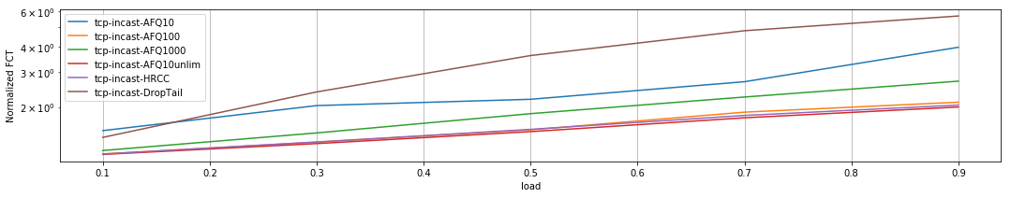
Mean FCT over all flows
Packet classification based on src/dst address
Packet classification based on fid

Slide 7
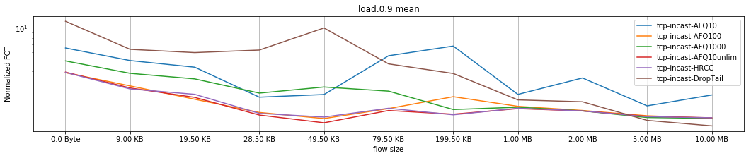
FCT of flows with different sizes
Packet classification based on src/dst address
Packet classification based on fid

Slide 8
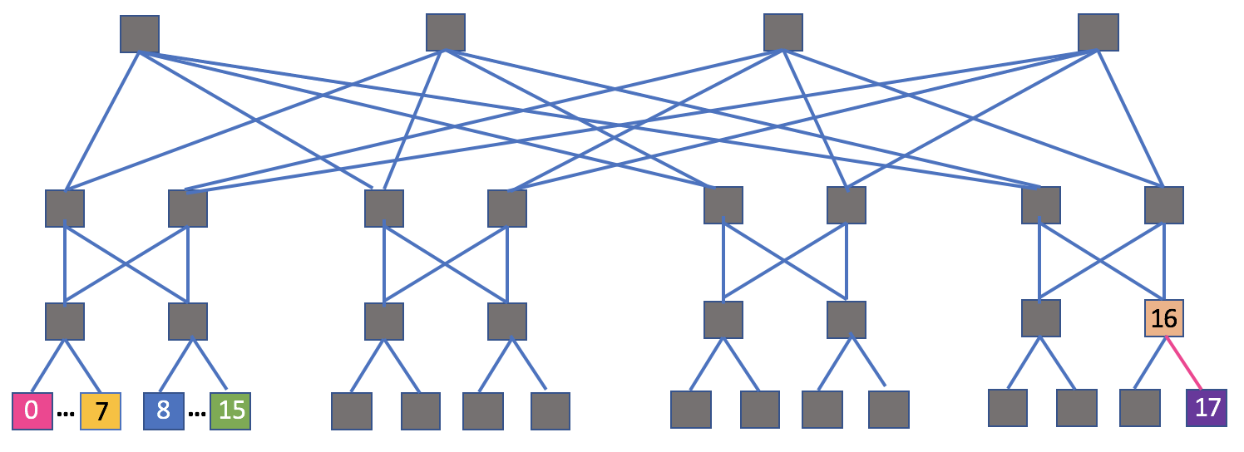
Set up:
Incast, single node, 16 connections, 8 hosts per edge switch
100Gbps
Scheduler applied here
40Gbps
Classify based on fid
1us*12=12us

Slide 9
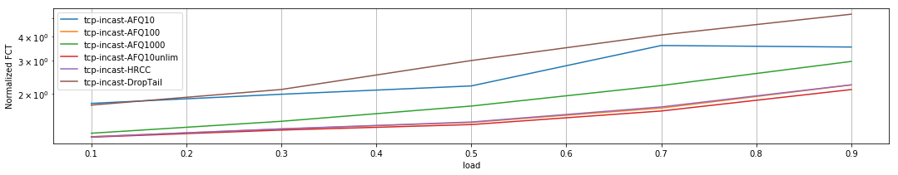
Mean FCT over all flows
Packet classification based on src/dst address
Packet classification based on fid

Slide 10
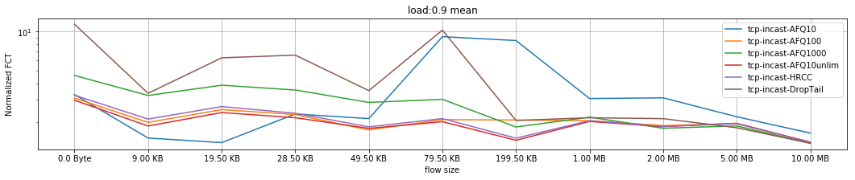
FCT of flows with different sizes
Packet classification based on src/dst address
Packet classification based on fid

Slide 11
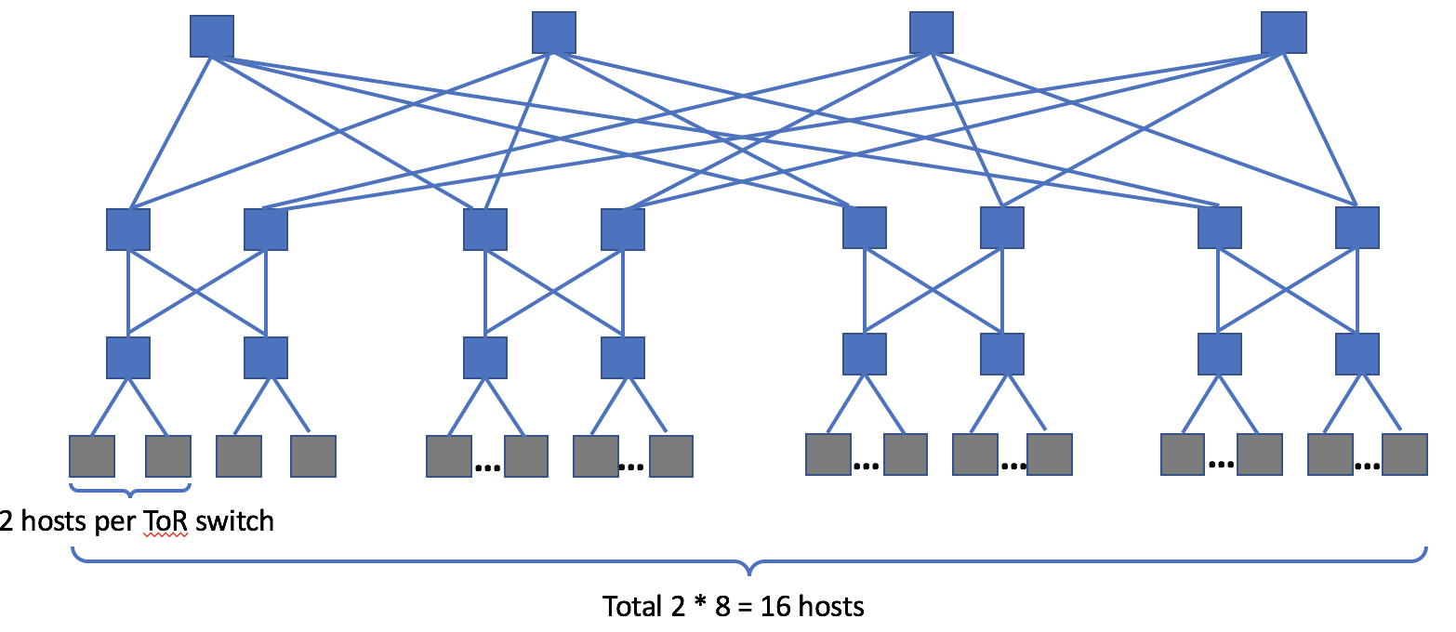
Set up:
Random pair, all links 100Gbps * 1us, apply scheduler on every switch

Slide 12
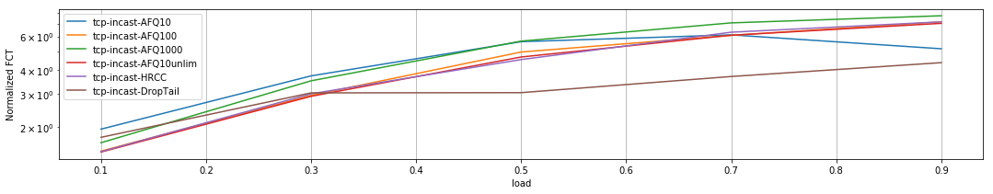
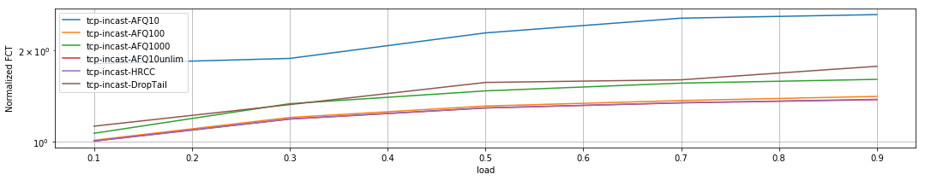
Mean FCT over all flows
4 pods, 16 hosts
8 pods, 128 hosts

Slide 13
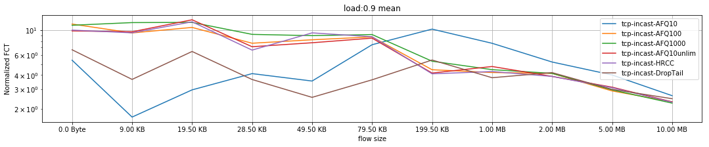
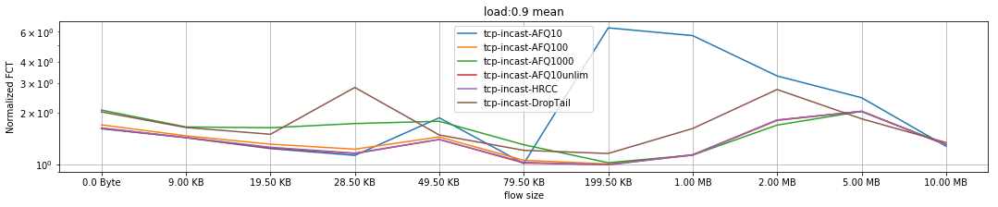
FCT of flows with different sizes
4 pods, 16 hosts
8 pods, 128 hosts

Slide 14
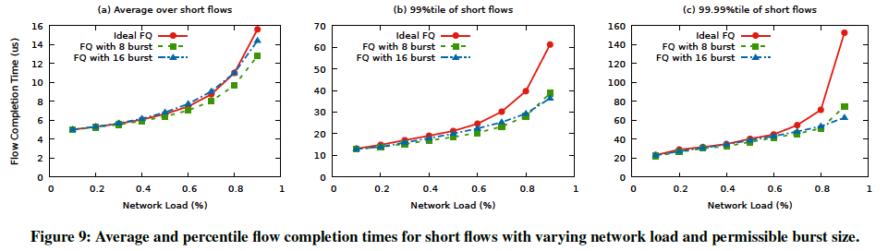
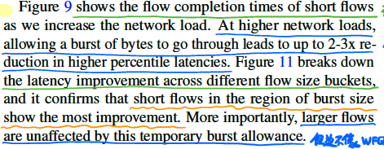
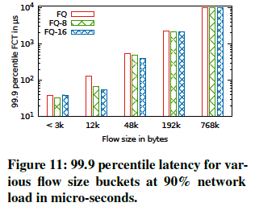
AFQ shows the FCT of short flows

Slide 15
Summary
Pkt classification based on addresses: Advantage in mean FCT
Pkt classification based on flow id: Advantage in short flow FCT
FCT advantages varies based on bandwidth and delay (BDP)
FCT advantages of random pair varies based on host number
To Do:
Try different BDP
Look into queue size and end-to-end delay
Try different host number of random pair

